Slide 1

Bangladesh Army International
University of Science & Technology (BAIUST)
Presented To,
Sabina Zaman
Lecturer,
Department of CSE, BAIUST,
Cumilla Cantonment, Cumilla
Presented by,
Md Sunjid Hasan – 1103082

Slide 2
About
Personality Profile Prediction.
Attributes : Nature, intuitiveness, Decision making & character approach.
Perceiving or Judging ???

Slide 3
Methodology
K-STAR
PART

Slide 4
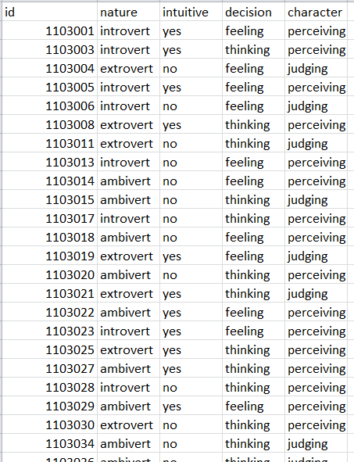
Dataset

Slide 5
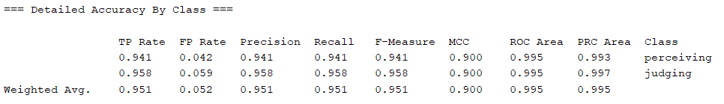
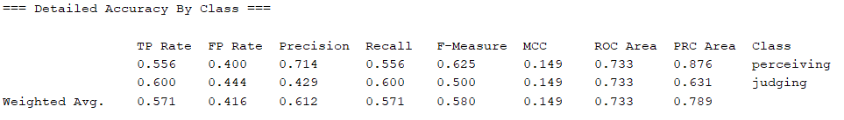
k-Star
Figure : Training Set Analysis.
Figure : Testing Set Analysis.

Slide 6
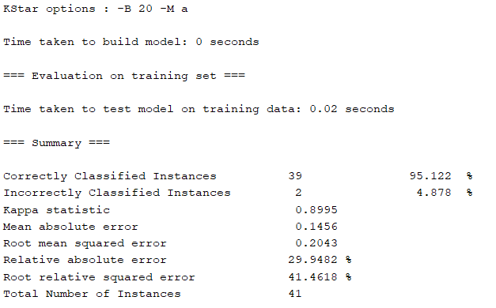
Figure : Training Set Accuracy.

Slide 7
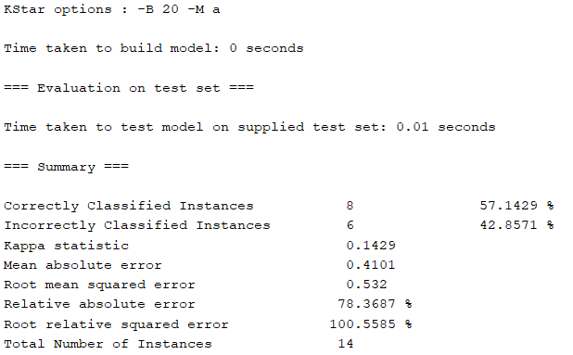
Figure : Testing Set Accuracy.

Slide 8
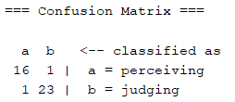
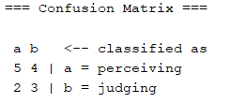
Figure : Training Set Confusion Matrix.
Figure : Testing Set Confusion Matrix.

Slide 9
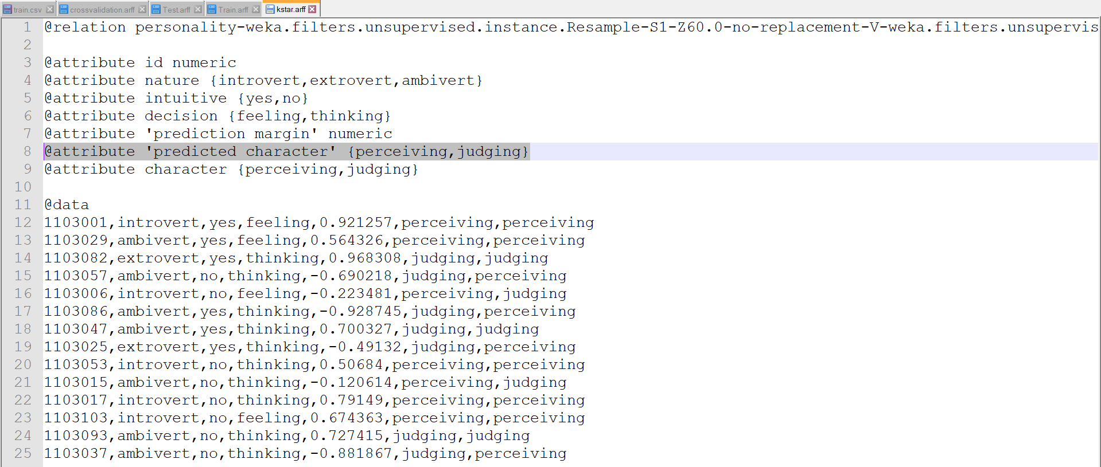
Figure : Result (K-Star).

Slide 10
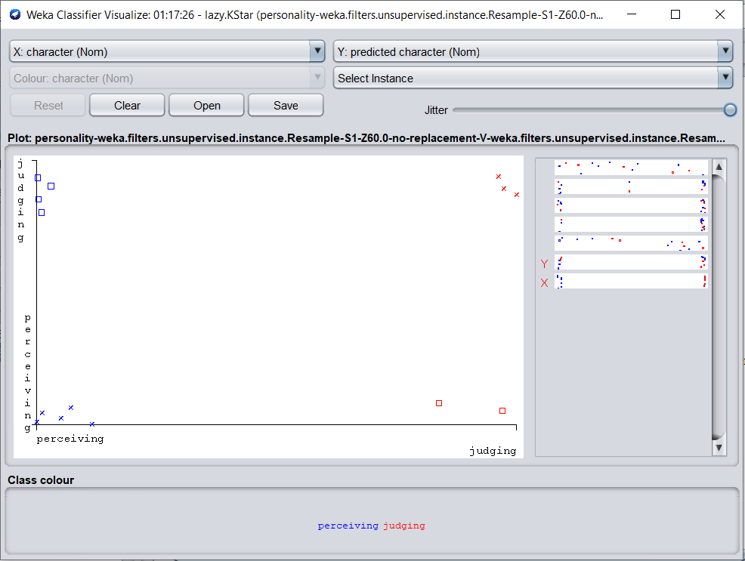
Figure : Classifier visualization (K-Star).

Slide 11
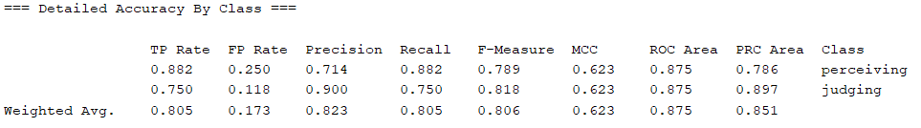
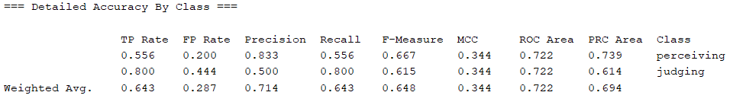
PART
Figure : Training Set Analysis.
Figure : Testing Set Analysis.

Slide 12
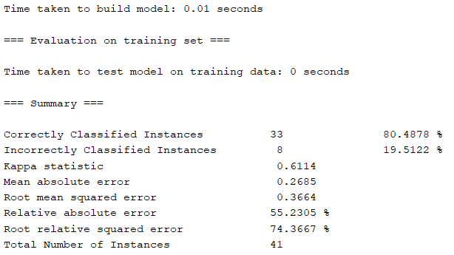
Figure : Training Set Accuracy.

Slide 13
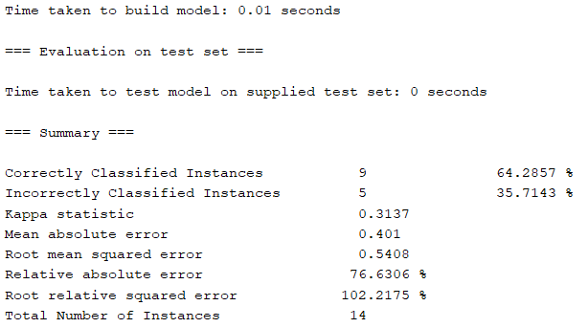
Figure : Testing Set Accuracy

Slide 14
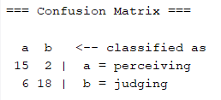
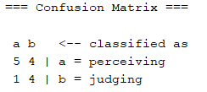
Figure : Training Set Confusion Matrix.
Figure : Testing Set Confusion Matrix.

Slide 15
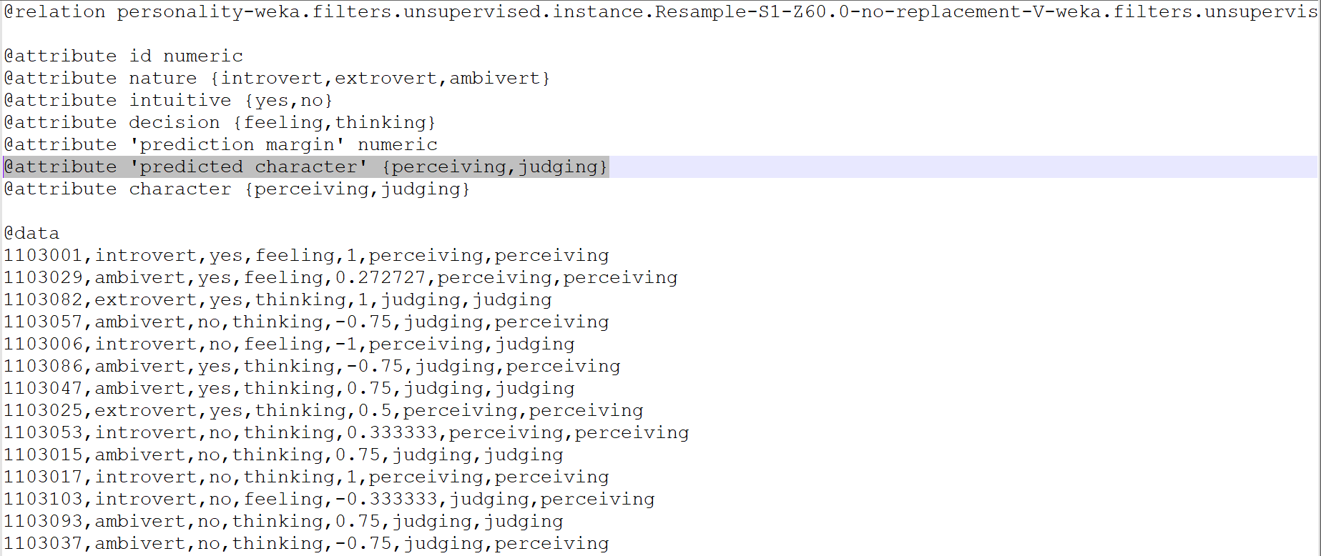
Figure : Result (PART).

Slide 16
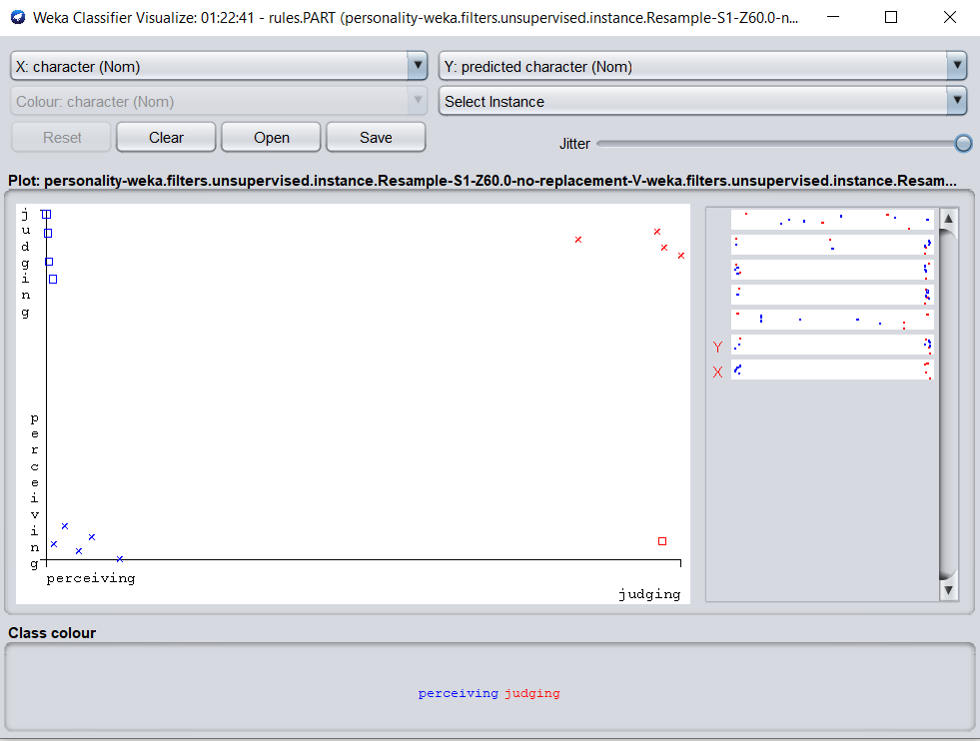
Figure : Classifier visualization (PART).

Slide 17
Comparison
Dominating portion : Nature - Ambivert
Not intuitive
Decision Thinking based &
Judging mentality.
K-Star PART
Correctly Classified 57.122% 64.2857%
Incorrectly Classified 42.857% 35.7143%

Slide 18
Conclusion
Dataset - CSE 3rd batch of Bangladesh Army international University of Science & Technology.
The data used to train and test the model does not represent the overall amount of personalities worldwide.
The outcomes are the flashes of personality based on perceiving persona and judging persona.

Slide 19


